Slide 1

Global Politics and the Architecture of Economic Complexity.
📑 Content:
Introduction to Global Politics.
Introduction to Economic Complexity.
Goal and Research Methodology.
Production and Population Projections.

Slide 2

Global Politics and the Architecture of Economic Complexity.
Geopolitics and politics, though related, are not identical.
Geopolitics increasingly influences corporate decision-making.
Global politics focused on external (international) affairs, not domestic politics.
Understanding the factors that drive economic development: Why did some countries catch up, while others got stuck in the middle?

Slide 3
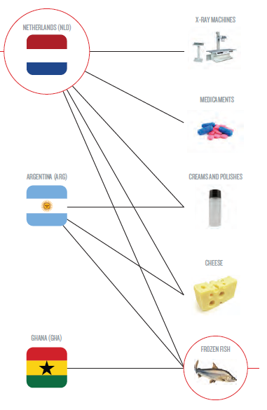
Global Politics and the Architecture of Economic Complexity.
Product Diversity.
Economic complexity measures how advanced and diverse a country's economy is, based on the types of products it makes and exports. (diversity)
📌 Example: A country that exports only raw materials is less complex than one that exports cars, electronics, and medical equipment.
The most attractive and competitive products tend to have a higher economic complexity index.
📌 Example: Semiconductors require advanced knowledge, skilled labor making them high in both competitiveness and economic complexity.
Source: The Atlas of Economic Complexity.

Slide 4
Global Politics and the Architecture of Economic Complexity.
Atlas Rankings Methodology.
With GDP and Export information
Population above 1,000,000
Average trade above $1B
Reliable data
Countries in Rankings
The Economic Complexity Index is a ranking of countries based on the diversity and complexity of their export basket.
High complexity countries are home to a range of sophisticated, specialized capabilities and are therefore able to produce a highly diversified set of complex products.
Source: Atlas of Economic Complexity.

Slide 5

Goal = What we want to achieve.
From a theoretical perspective, a link can be drawn between economic complexity, export flows, and foreign direct investment (FDI) location decisions.
What does economic complexity offer us? It provides strategic guidance: it tells us where to go.
To suggest that, according to this study, the destination of firms is important, as well as the complex process of internationalization.
Links internationalization with Economic Complexity through shared clusters and keywords.

Slide 6
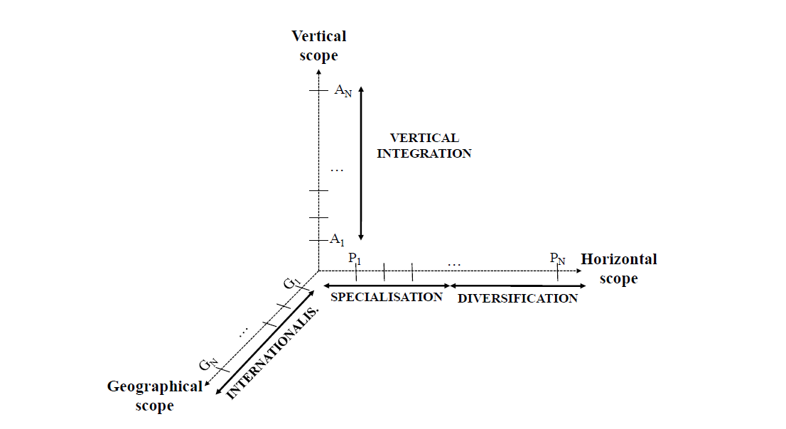
Economic Complexity = What to do

Slide 7
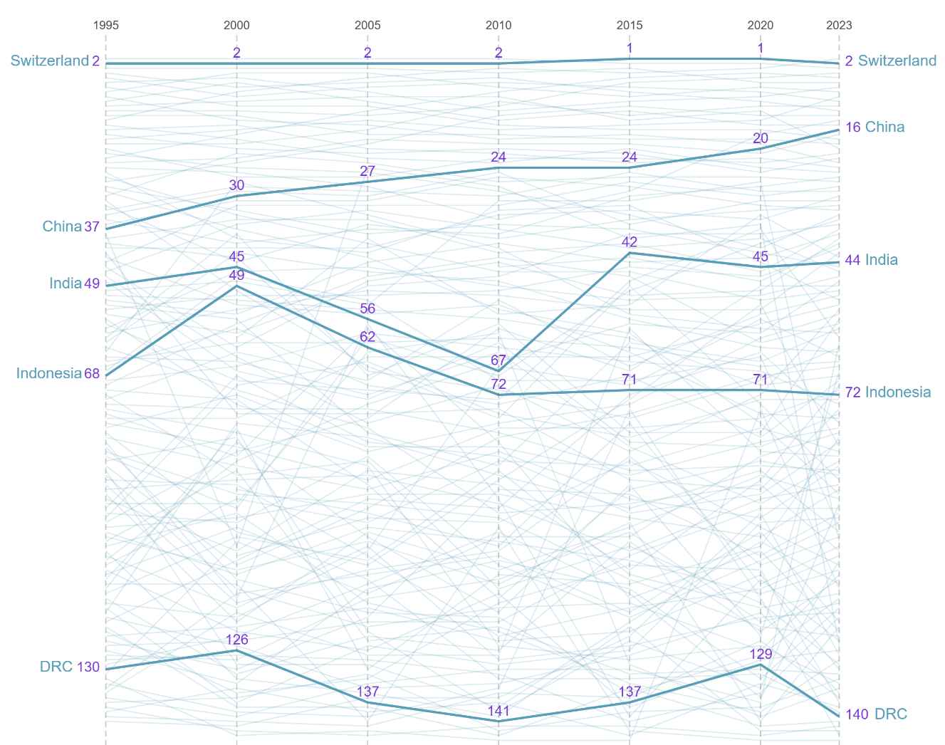
Why did some countries catch up in terms of Economic Complexity, while others got stuck in the middle?
Country Complexity Rankings.
Geographic location can shape a country's access to resources, trade, and development.
Countries that invest in R&D, education, Culture, Institutions and technological adoption tend to escape the poverty trap.
Corruption, weak legal systems, and poor infrastructure can slow down progress.
After African independence, many countries maintained that extractive model, without productive diversification.
Source: Harvard Growth Lab, Atlas of Economic Complexity.

Slide 8
Table x . Keywords and search string
Concept | Keywords
Economic Complexity | economic complexity product space product sophistication product relatedness product complexity
Internationalization | foreign direct investment global* (global, globalization …) internation* (international, internationalization …) export* (exportation, exports, …) location multinational* (multionational, multinationals) subsidiar* (subsidiary, subsidiaries)
Search string | TS=("economic complexity" OR "product space" OR "product sophistication" OR "product relatedness" or "product complexity") AND TS= (fdi OR "foreign direct investment" OR global* OR internation* OR export* OR location OR multinational* OR subsidiar*)

Slide 9
Term frequency. VOSviewer Analysis of Selected Literature (n = 400): First Insights.
Growth, Economic growth, Trade, Countries, Innovation, Globalization, Quality, Spillovers, China, Export diversification, Diversity, Impact, Regression, Energy, International trade, Liberalization, Income inequality, Foreign Direct Investment (FDI), Sophistication, Developing countries, Productivity, Knowledge, Development, Institutional quality, Empirical evidence, Investment, Global value chains, Renewable energy, Cointegration, Africa, Economic complexity index, Institutions, Volatility, Specialization, Comparative advantage, Determinants, Internet, Education, Governance, Inequality, Urbanization, Impact.

Slide 10
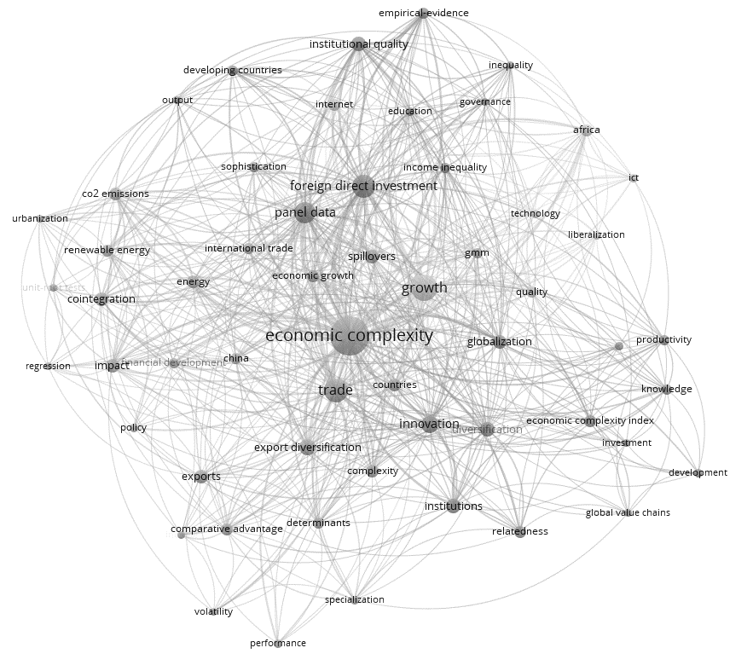
Term frequency. VOSviewer Analysis of Selected Literature (n = 400): First Insights.

